Slide 1
Work report
王军亮
20150530

Slide 2
I. The modification of pCT5e
SOE PCR:
Double digest:
MH-G3Long MH-G3Short
MH-G3Long[NotI-BamHI] , MH-G3Short[NotI-NdeI]
Conclusion:
The new kit(From Weng lab) is weak to extract small DNA fragment from agarose gel.

Slide 3
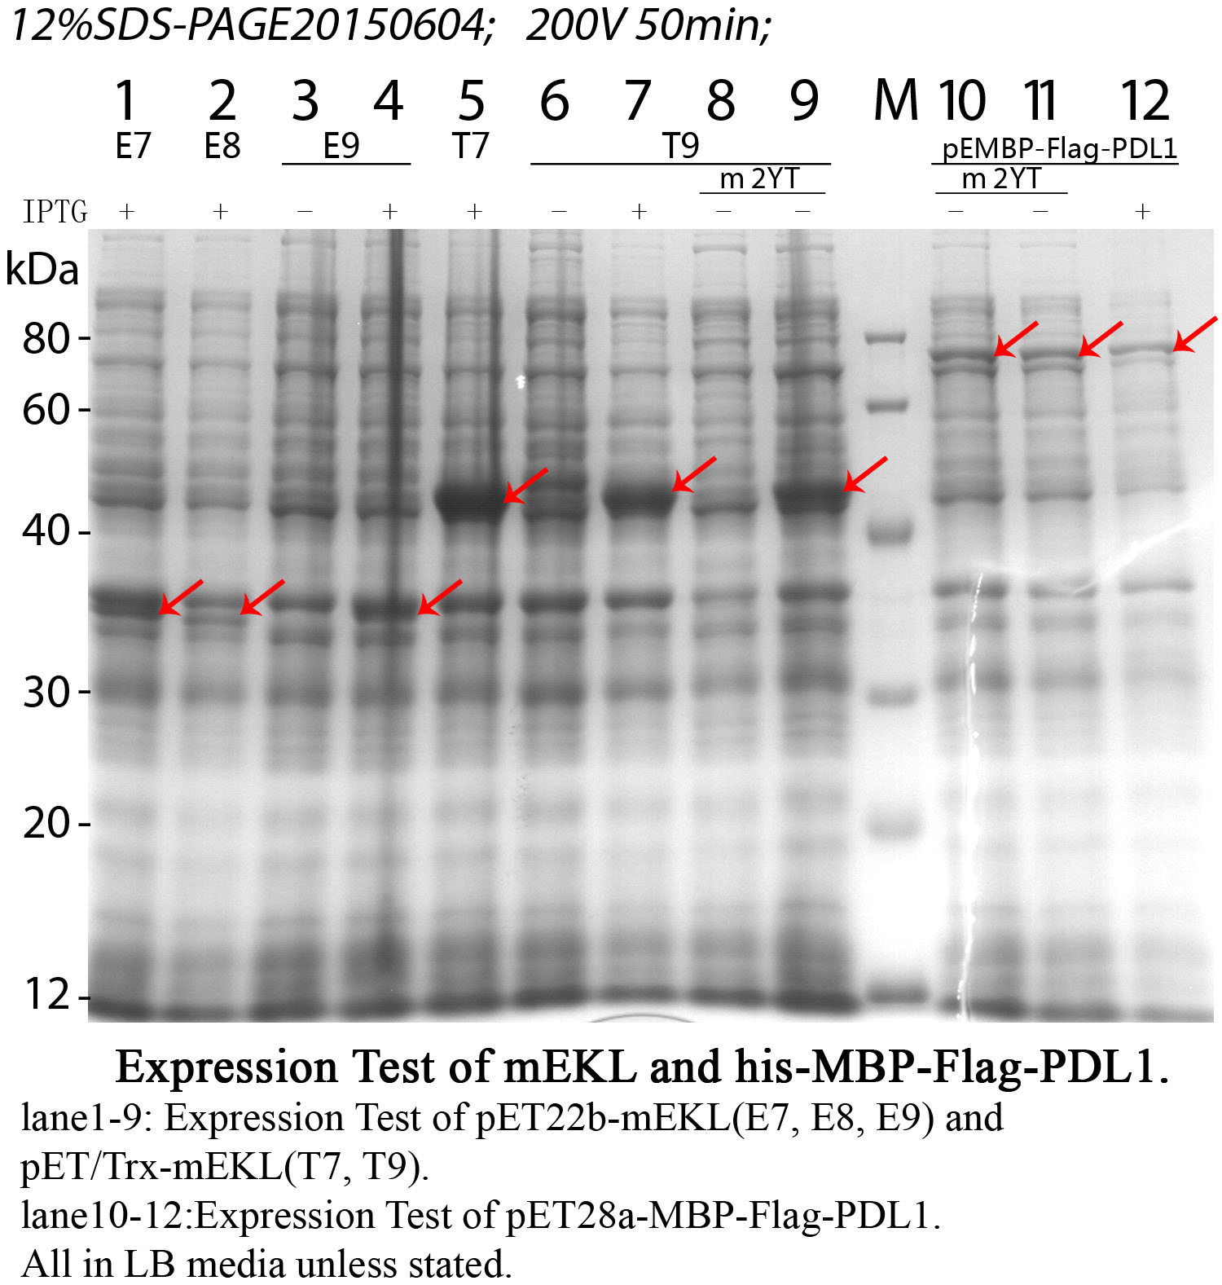
II. Mouse enterokinase light chain(mEKL)

Slide 4
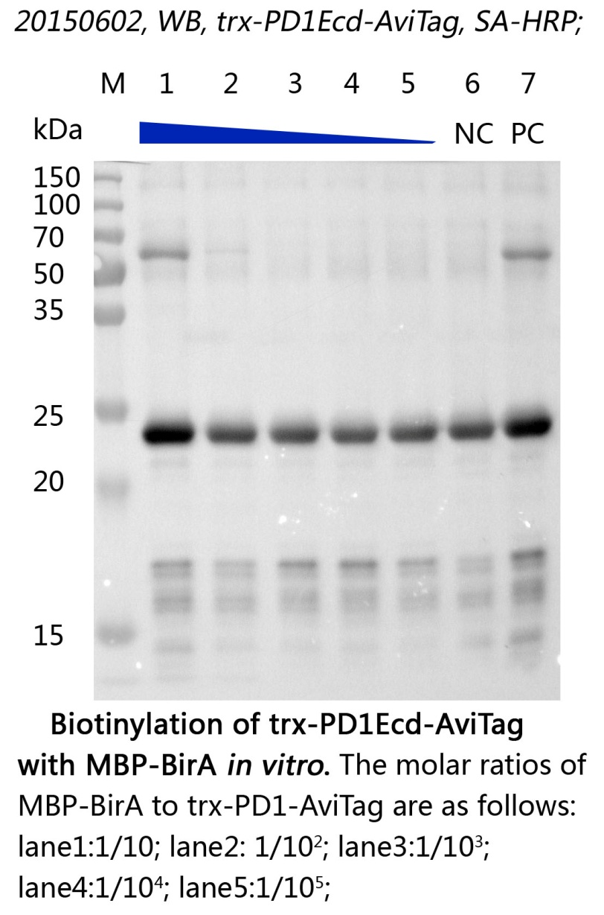
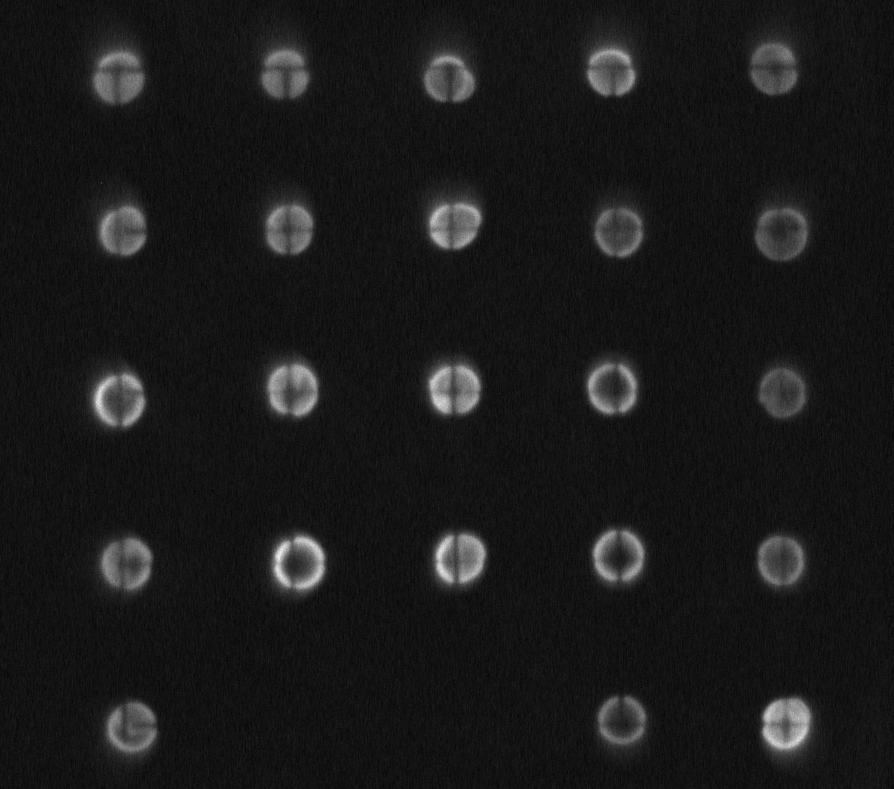
III. Biotinylation of trx-PD1Ecd-AviTag
Dot Blot: ratio of enzyme to POI-AviTag is marked below.
1/10, 1/20, 1/40, 1/60, 1/80
1/100, 1/200, 1/400, 1/600, 1/800
1/1000, 1/2000, 1/4000, 1/6000, 1/8000
1/10000, 1/20000, 1/40000, 1/60000, 1/80000
1/100000, NC PC

Slide 5
When we amplifying the reaction from 50ul to 500ul, the protein precipitate at once.
Solution: (with WHF)
We find the buffering capacity of 0.5M Gly-HCl is so low that the final reaction pH is nearly 3; 10xBioMixA has been changed to 0.5M Tris-HCl.
We will do the above experiment again.
If the step is done ,we consider the next steps:
- Using sephadex G-75 to remove the excess free biotin.
- Do a pull down assay to try the effect of biotinlation.

Slide 6
Plan for next week
Get the new phagemid.

